Slide 1
US HOUSE PRICE PREDICTION BY USING MECE FRAMEWORK
By
NISHA SIVAKUMAR
+91 9176497245
nishasivakumar54@gmail.com

Slide 2
OBJECTIVE
This project is to find the factors that could influence Residential home prices across the US over the next decades by using MECE framework

Slide 3
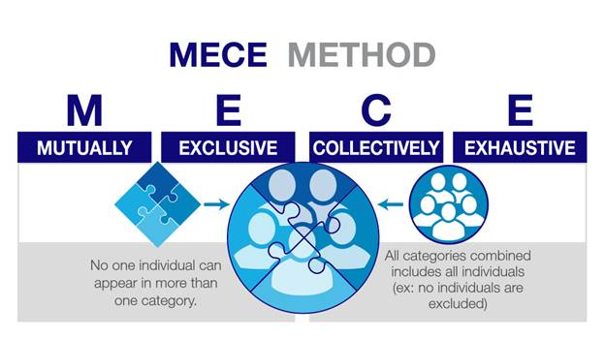
MECE FRAMEWORK

Slide 4
SUPPLY
A few key aspects to look at include:
How many houses existing?
how many newly built per year?
split by reasonable geographic units (coastal cities, in-land cities, in-land rural)
What are the Government policies towards the new houses going to build?
Cost of Raw Materials?
What is the rate of new home construction?
How much is this expected to change?

Slide 5
DEMAND
A few key aspects to look at include:
Income Level
US Population + new home purchasing
US Population + Investment in housing
Foreign population + investment in housing
Historical price rises
Building materials costs
development of household sizes
demographic shifts from rural to cities
Crime rate per Region
Public Schools
Hospitals
unemployment rate per region

Slide 6
DATA USED FOR THIS PROJECT
NAME | DATA SOURCE
Builder Economics Dataset | https://www.kaggle.com/zillow/zecon
Crime rate Dataset — US Crime rates by County | https://www.kaggle.com/mikejohnsonjr/united-states-crime-rates-by-county
School Dataset — USA Public Schools | https://www.kaggle.com/carlosaguayo/usa-public-schools
Income Level Dataset — USA Income Levels by United States Census Bureau | https://data.world/uscensusbureau/acs-2015-5-e-income/workspace/file?filename=USA_ZCTA.csv
Income Dataset by United States Census Bureau | https://www.census.gov/programs-surveys/acs/
Hospital Dataset | https://www.kaggle.com/carlosaguayo/usa-hospitals/version/1
Hospital Rating Dataset | https://www.kaggle.com/center-for-medicare-and-medicaid/hospital-ratings
Unemployment Dataset — USA Unemployment rate Dataset | https://www.kaggle.com/carlosaguayo/2018-unemployment-rate-by-county/version/1

Slide 7
DATA STORY & EXPLORATORY DATA ANALYSIS
Which states should you buy a house in?
Home value change for top expensive states?
Top states with most Rent values?
Median Home value per square foot in different states?
Home prices per square feet over the years?
Top 7 States of Median Price Per Sqft?
Bottom 5 states of Median Listing Price per Sqft All Homes?
Median Rental Price for all homes
Median Listing Price for all homes

Slide 8
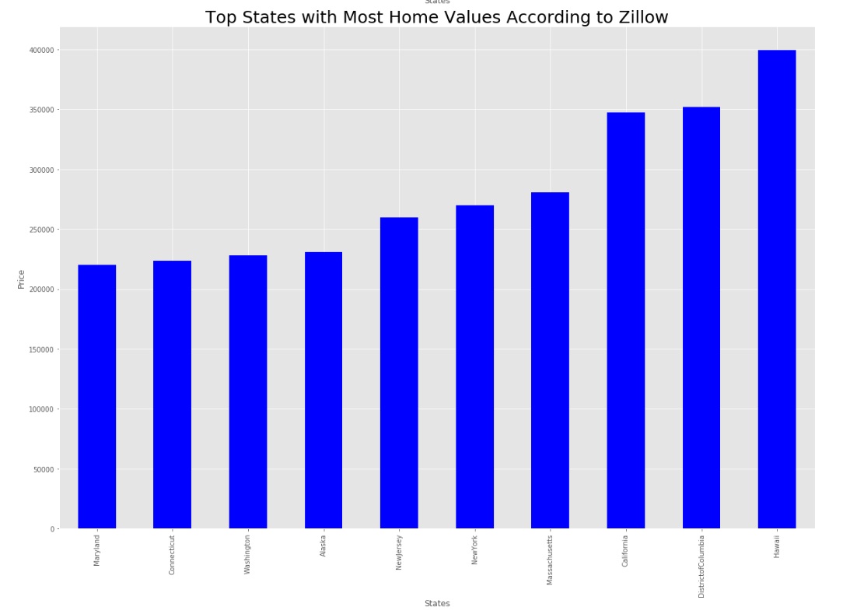
which states should you buy a house in?

Slide 9
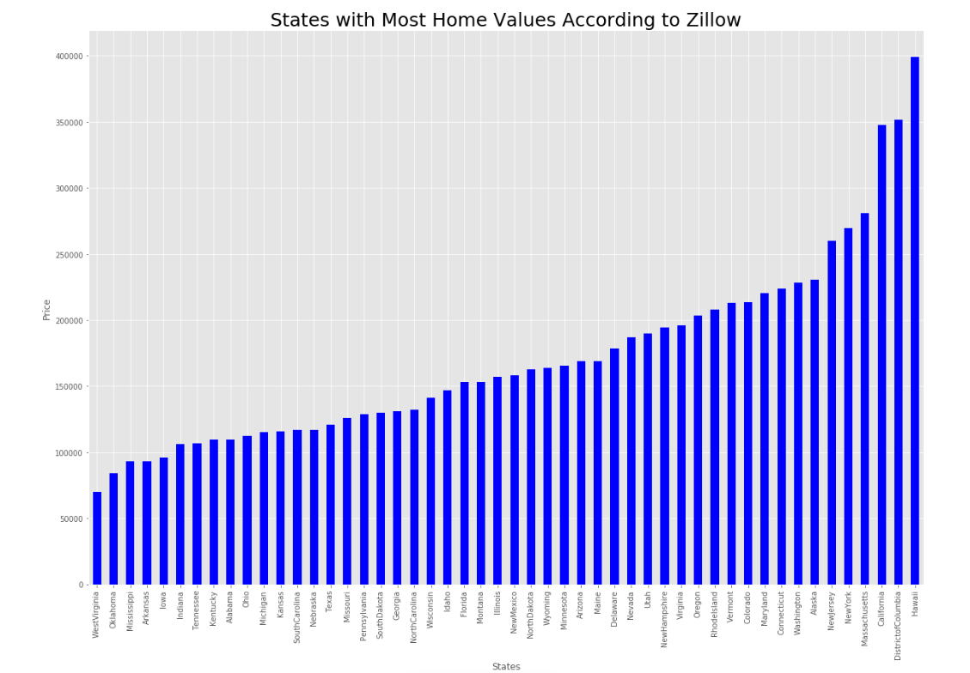

Slide 10
According to thiss estimate, Hawaii is the top state with average home value close to 400K. The second most home value state is the District of Columbia with an average of 350K. Some other upper end states are California, Massachusetts, New York, Alaska, Washington, Connecticut, Maryland and Colorado. However, the question is how has the price changed over time for these states? Because if we are looking to buy a house in one of these states, we need to know how the prices have changed over time

Slide 11
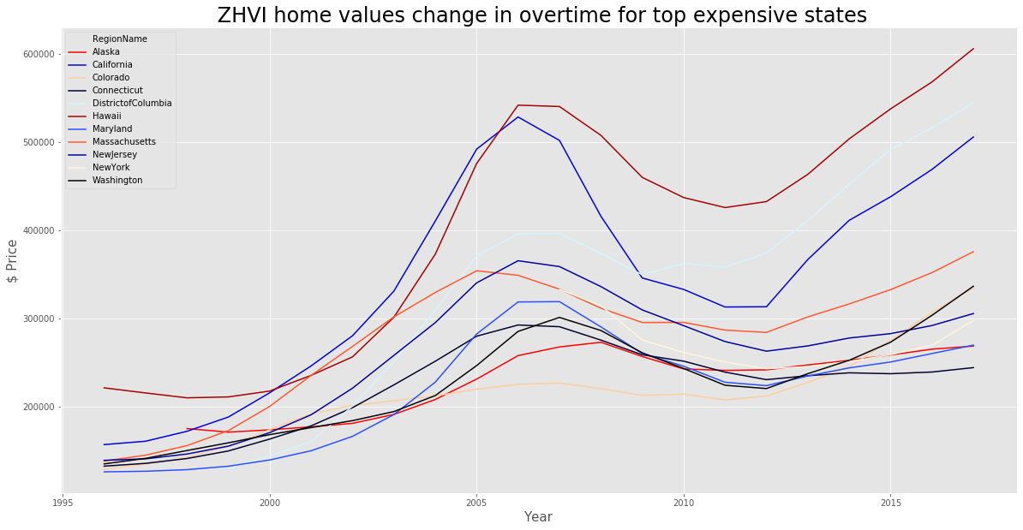
Home value increase over time in these top expensive states

Slide 12
It looks like Hawaii, District of Columbia and California are in a race to increase ZHVI average since 2010 according to this dataset. Meanwhile, other upper-end states such as New York and New Jersey started slow and went slightly downhill until 2012 then prices seemed to increase with New York accelerating slightly faster than New Jersey. Colorado, on the other hand, has continuously gone uphill in this chart keeping it constant with Connecticut at around 330K in 2017

Slide 13
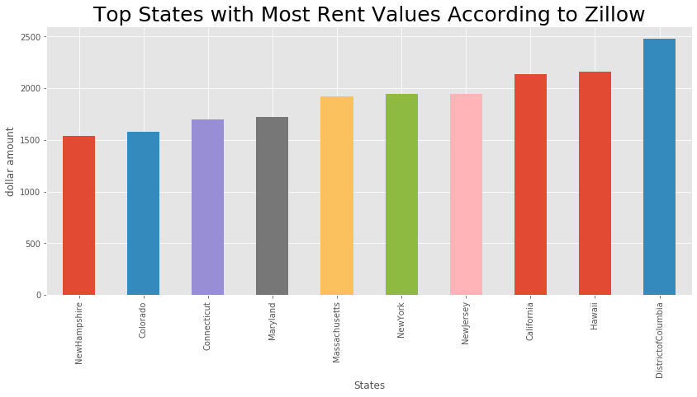
Top states with most Rent values

Slide 14
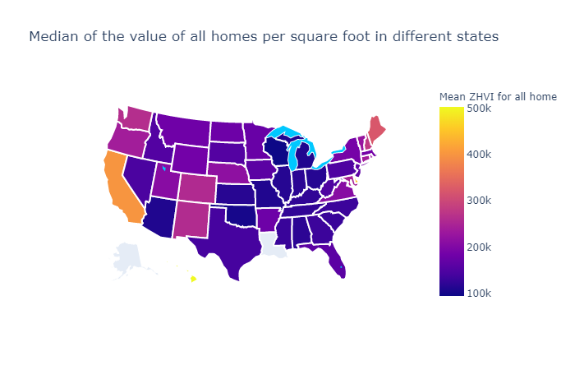
Median Home value per square foot in different states As one can see California has the highest and Wisconsin has the lowest median home value per square feet

Slide 15
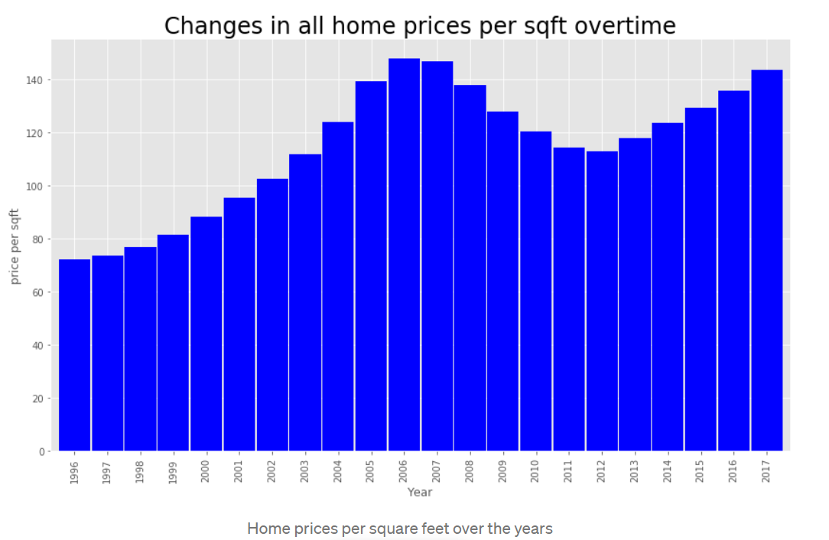
Home prices per square feet over the years It looks like housing price increased during 2005–2008 and decreased during 2011–2012

Slide 16
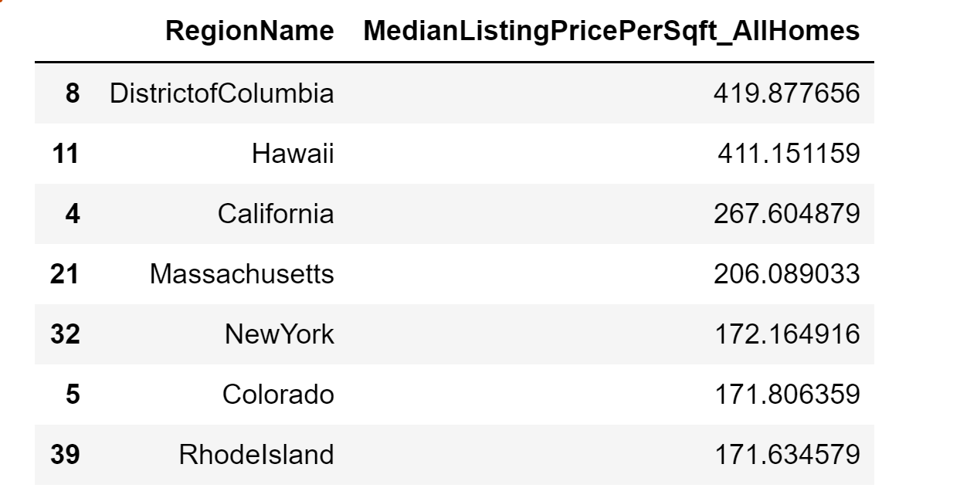
Top 7 States of Median Price Per Sqft These are the top 7 states of Median Listing Price per Sqft All Homes

Slide 17
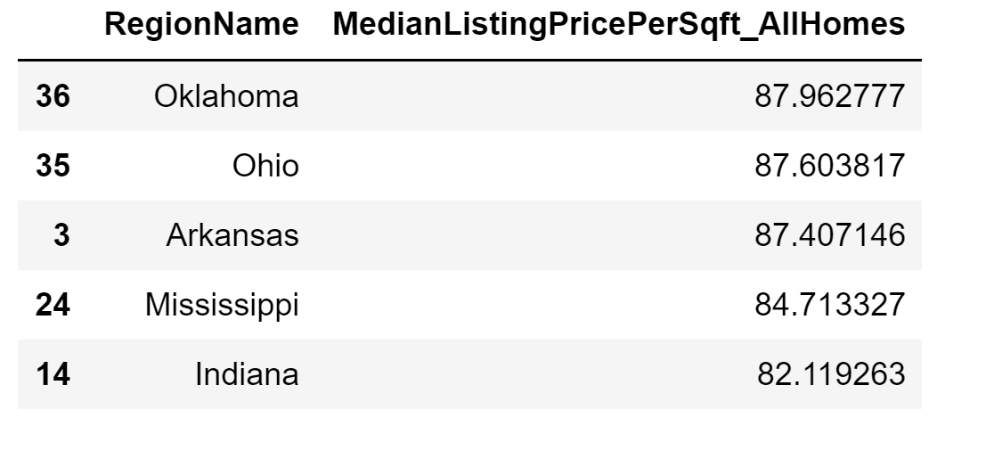
Bottom 5 states of Median Listing Price per Sqft All Homes

Slide 18
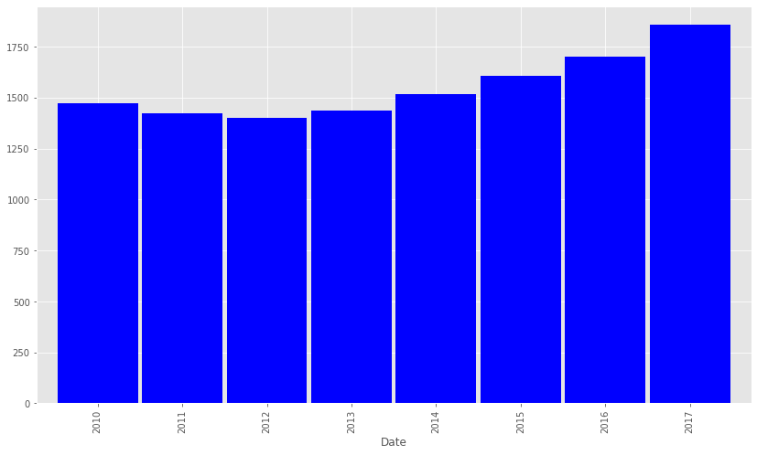
Median Rental Price for all homes Median rental price for all homes has increased from 2012 to 2017 and they decreased slightly from 2010 to 2012

Slide 19
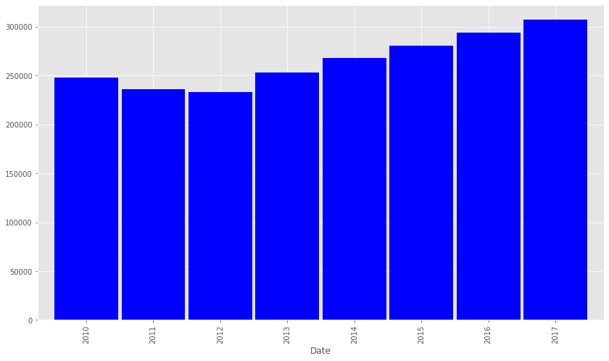
Median Listing price for all homes over the years Median Listing prices for all homes have increased from 2012 to 2017 and they decreased from 2010 to 2012

